Slide 1
Cloud Computing
-Nikhil Patil
Karmic Embedded Pvt. Ltd.

Slide 2
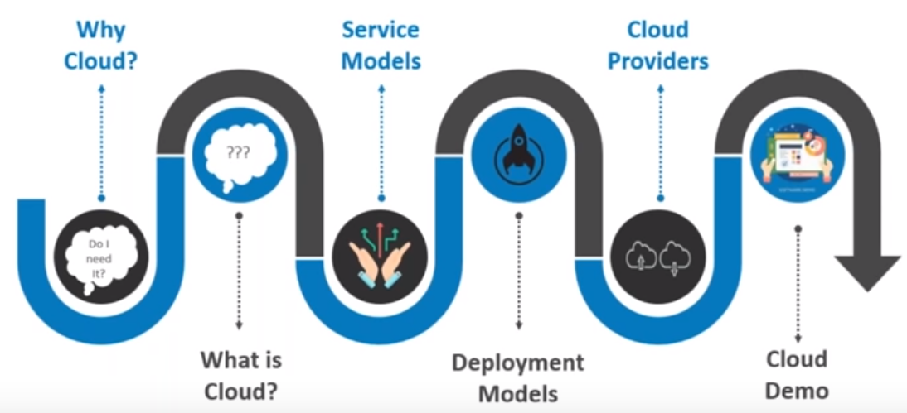
Contents

Slide 3
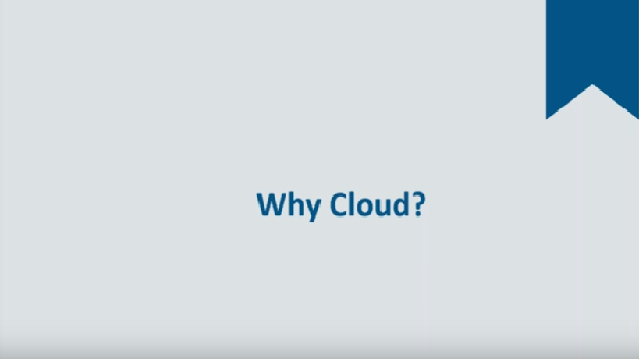

Slide 4
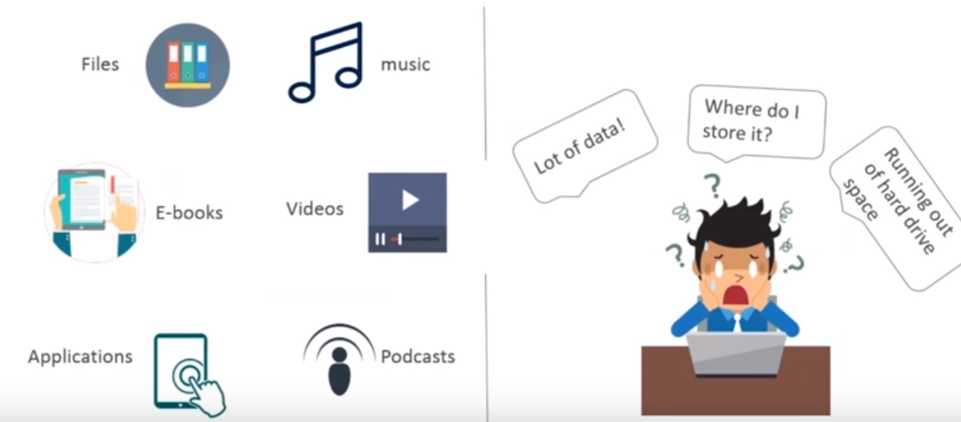

Slide 5
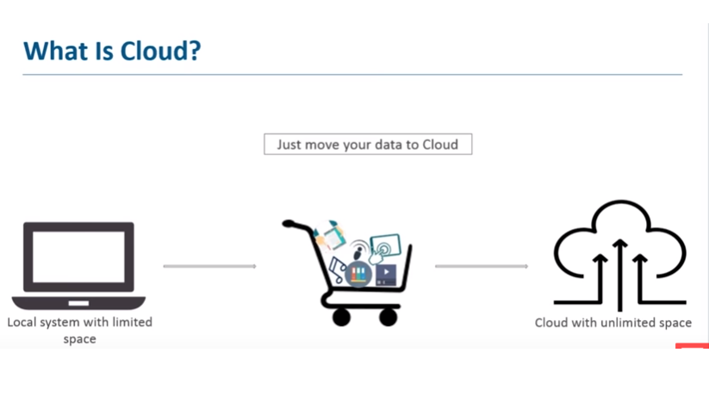

Slide 6
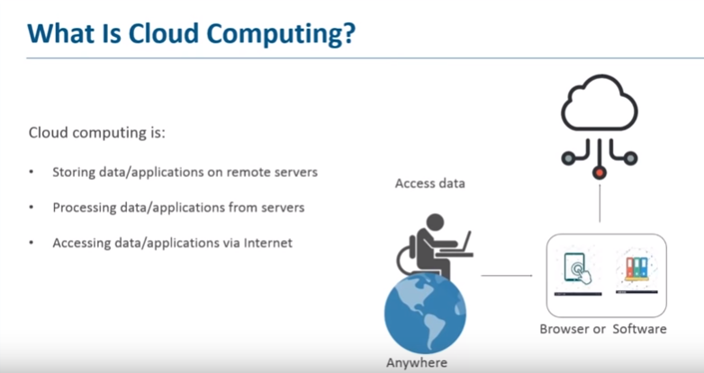

Slide 7


Slide 8
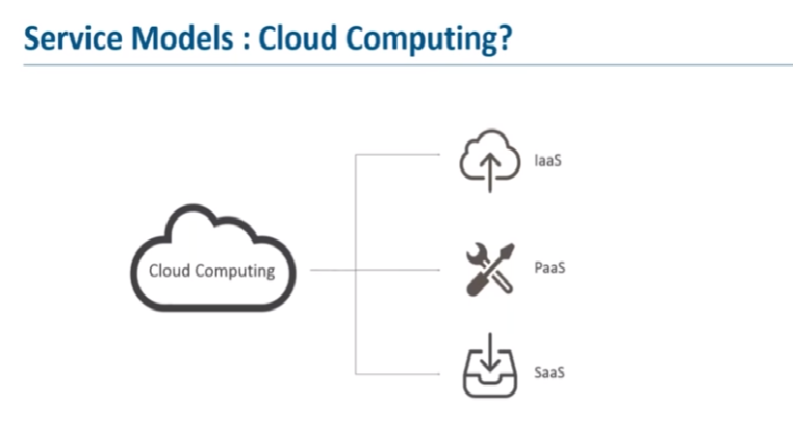

Slide 9


Slide 10
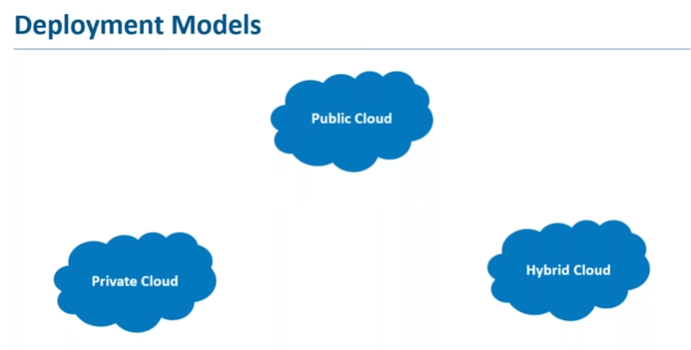

Slide 11


Slide 12
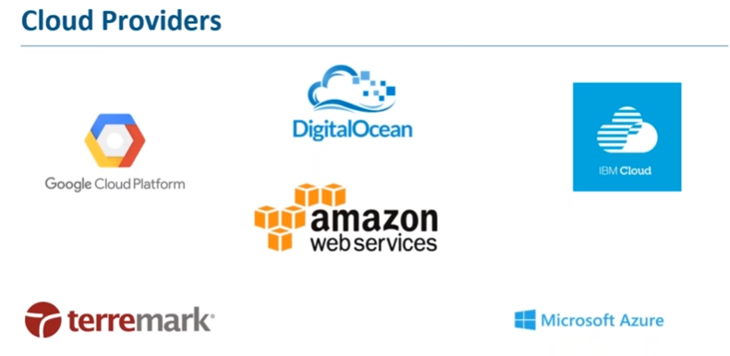

Slide 13
TIME FOR DEMO

Slide 14
THANK YOU ALL
ANY QUESTION’S ?

